Slide 1

Python Basics

Slide 2
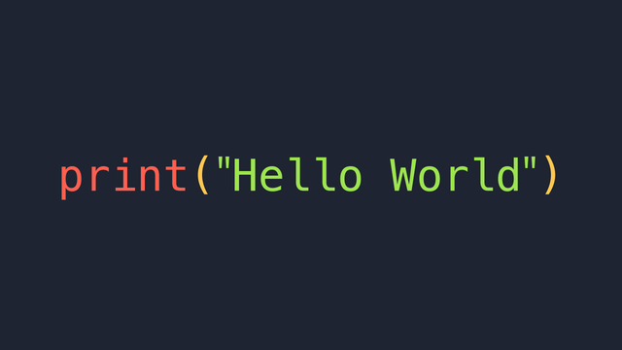
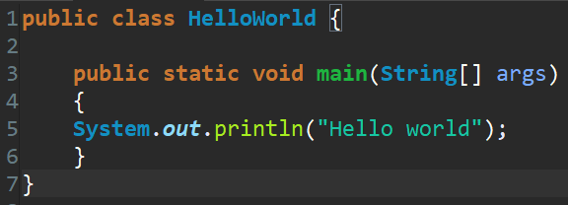
Why Python?
It’s a popular programming language.
It’s got many applications (automation, web development, data science).
Its syntax is very similar to written English.
It’s straightforward to learn.
Python files or scripts have the .py extension
PYTHON VS. JAVA

Slide 3
Data Types
Basic Data Types
Booleans (True/False)
Integers (Whole numbers)
Floats (Decimal Numbers)
Strings (Sequence of characters “words”)
Complex Data Types
Lists (Arrays)
Tuples (Immutable Arrays)
Dictionaries (Hashed Maps)

Slide 4
Variables
“Boxes” that store data to be used later in the program.
Python is dynamically typed.
To declare a variable just write: var_name = value
All variable names must start with either a lowercase or an uppercase letter.
Use variable names that are related to the data you store on them.
Conventions
Use lowercase letters for variables whose values are meant to change.
Use uppercase letters for constants (They don’t exist at all in Python).
Use snake casing (to_write_like_this) for variables whose names have 2 or more words.

Slide 5
Comments
Text ignored by the Python interpreter used to leave notes in your code
Programmers use them to let others know how their code works, what needs to get done, or for any other thing.
Sometimes the other programmer will be you after some weeks.
ALWAYS COMMENT YOUR CODE IF YOU’RE GOING TO FORGET HOW IT WORKS IN THE NEXT 2 WEEKS
Comments in Python are preceded by the # character

Slide 6
Command Line I/O Operations
STDIN (Standard Input)
It’s input data that comes from the keyboard.
Use the input() function to get STDIN from the user.
Save the result in a variable to be able to use it later.
Ex:
STDOUT (Standard Output)
A program’s output printed to the console.
Use the print() function to display the results of your program to the console.
Ex:

Slide 7
Small Exercise 1
Write a short program that asks the user his name, his intended major and print it to the console.

Slide 8
Arithmetic Operators
Addition (+):
Subtraction (-):
Multiplication (*):
Division (/):
Power (**):
Modulo (%):
THE MODULO OPERATOR IS USED A LOT TO CHECK FOR EVEN AND ODD NUMBERS.

Slide 9
Type Conversion
Use the bool() function to convert an object to its boolean equivalent
Use the int() function to convert numeric data to an integer.
Use the float() function to convert numeric data to a float.
Use the str() function to convert data to string.
Why is this important?
The input() function returns all data as strings.
You can’t concatenate numbers with strings to print them (We’ll see this later).

Slide 10
Small Exercise 2
Make a small program that gets two numbers from the user and executes all arithmetic operations covered with those numbers. Print each result to the console.

Slide 11
Strings
Immutable data types
Concatenation: Joining two strings together.
Ex:
Indexing: Referring to characters of a string with numbers
THE FIRST CHARACTER IS ALWAYS REFERENCED WITH INDEX 0
Ex:
Slicing: Extracting pieces of strings.
First index is inclusive. Last index is exclusive.
Ex:
Use the len() function to get how long a string is.
Ex:
There are many more ways to deal with strings called STRING METHODS. Find more info about them here:
https://www.w3schools.com/python/python_ref_string.asp

Slide 12
Small Exercise 3
Take input from STDIN, get it’s length and make a substring that takes everything but the last character.

Slide 13
Comparison Operators
Use them to compare/contrast your data.
Equality:
Inequality:
Greater than:
Lesser than:
Greater or equal:
Smaller or equal to:
More info and examples may be found here:
https://www.w3schools.com/python/gloss_python_comparison_operators.asp

Slide 14
Logical Operators
They are used to construct complex logical statements
AND: True when all expressions are true
Ex:
OR: True when at least one expression is true
Ex:
NOT: Inverse the “veracity” of a logical statement
Ex:
in keyword
Check if a value is present in a string, list, tuple, etc.
Ex:
More info on logical operators may be found here:
https://www.w3schools.com/python/gloss_python_logical_operators.asp

Slide 15
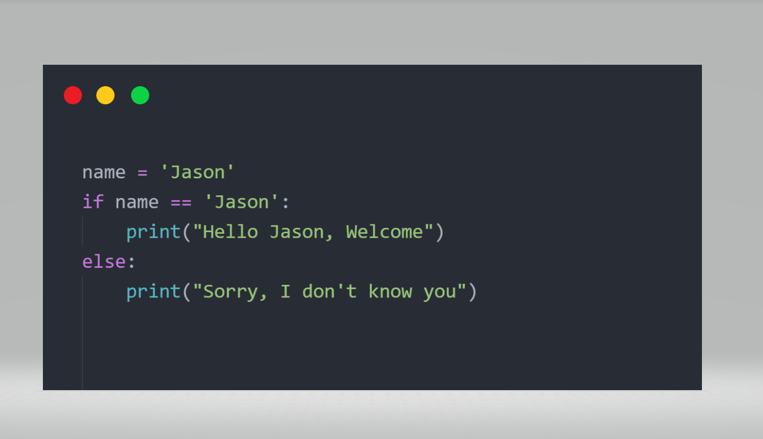
If-statement
Used to make choices according to a condition.
Allows your code to follow your logic.

Slide 16
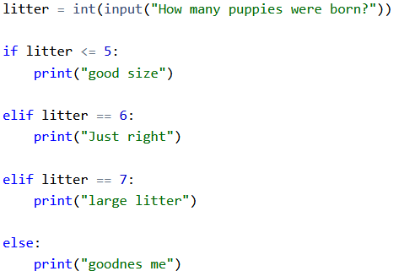
Elif
For cases that involve more than two possibilities, use the elif statement which stands for (else if).

Slide 17
Small Exercise 4
Write a small program that asks the user how the feel today.
If they say “bad” or “Bad” print out: “How can I help”?
If they say “regular” or “Regular” print out: “You had a boring day.”
If they say “good” or “Good” print out: “Nice”.
If they say “awesome” or “Awesome” print out: “You conquered the world today.”
For all other cases print out. “Meh, I didn’t even care in the first place.”

Slide 18
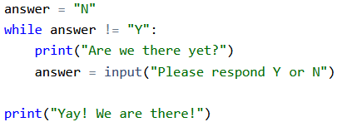
While Loop
In programming, while loops are used to execute tasks repeatedly until a certain condition tells them to stop.
Use them to execute code as long as a certain condition is true.

Slide 19
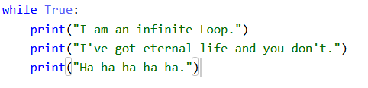
WARNING
While loops WILL run FOREVER unless you make a condition that WILL cut them off.
You must manually cancel them by exiting the program or with the shortcut Ctrl + C
NEVER WRITE INFINITE LOOPS !!!

Slide 20
Small Exercise 5
Take the program from Small Exercise 4 to keep asking the user how they feel until they enter the string “Stop”

Slide 21
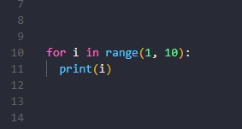
For Loops
They are used to iterate through a sequence of objects.
They are used a lot to address individually items in strings, lists, and ranges of numbers.

Slide 22
Small Exercise 6
Make a program that prints out the characters of a string from STDIN one at a time.

Slide 23
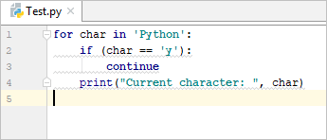
Special Loop Statements
continue
Use it to skip an iteration of the loop.

Slide 24
Small Exercise 7
Make a program that prints out all even numbers from 1 to 100.

Slide 25
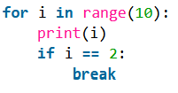
Special Loop Statements
break
Use it to force exit from a loop.

Slide 26
Small Exercise 8
Make a program that continuously asks the user for a number, but force exit from it when the user does not enter digits.

Slide 27
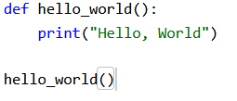
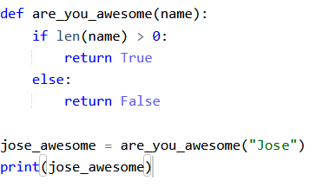
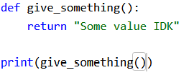
Functions
Separate pieces of code used to execute determined tasks.
They may take input through arguments and may return output.
You MUST CALL functions in order to execute their code.

Slide 28
Scope
Variables outside functions are called global. They may be read by the entire program. But not necessarily changed.
Variables inside a function are called local. They cannot be accessed outside the function.
Have this is mind as you learn how to manage more complex programs that involve the usage of different functions.
It is recommended to have your code split into different functions that each execute a specific task and then call them inside a main() function

Slide 29
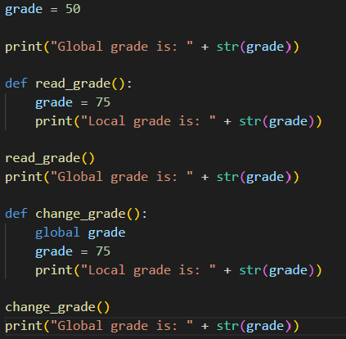
Scopes Example

Slide 30
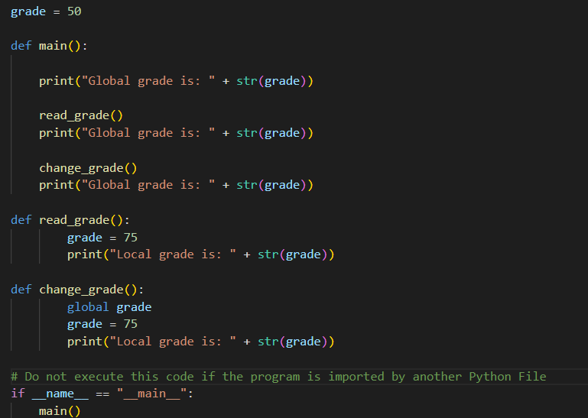
Scopes Example with main()

Slide 31
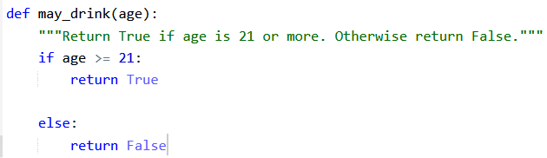
Docstrings
The “comments” of functions used to summarize what functions do, what type of data they use as input and what data type they return.
It’s the description of functions that appear when the help() function is used.
It’s recommended you add docstrings to your functions unless their names completely describe them.

Slide 32
Small Exercise 9
Write two functions, one that returns true when a number is odd and false when a number is even.
Then make a program that continuously asks the user for a number and print out if that number is even or odd.
Exit the program when the user enters “Stop”.
Use comments and docstrings in your code.
Encapsulate the meat of the program (The part of the program that defines control flow and that calls the other functions) inside a main() function.

Slide 33
Lists
Used to store multiple items in one variable
In Python you may store objects of any data type inside the same list.
Use indexing to refer to individual items of a list
You may change list elements of a specific index.
Use slicing to extract a sublist from a list
More ways to deal with lists may be found here:
https://www.w3schools.com/python/python_ref_list.asp

Slide 34
Small Exercise 10
Make a program that continually asks the user for integers. Then add only even numbers to a list and print that list.

Slide 35
Tuples
Same as lists but you cannot change the elements it contains.
You cannot add, replace, or remove elements from a tuple.
Why should they be used?
Sometimes, you need to with data that does not need to be changed or must not be changed.
They are a bit quicker to compute than lists.
Use the list() method to convert a tuple to a list
Use the tuple() method to convert a list to a tuple

Slide 36
Small Exercise 11
Get how many times the numbers 50 appears in the tuple

Slide 37
Dictionaries
Kind of like lists, but instead of using indexes they refer to data stored in them with keys.
They use key value pairs
Special things you may do with dictionaries may be found here:
https://www.w3schools.com/python/python_ref_dictionary.asp

Slide 38
Final Exercise
Make a program that takes a string from STDIN, get the letters present in that string and count how many times they repeat.

